Slide 1


Ikigai
The purpose of living

Slide 2

Ikigai (生き甲斐)
The reasons of being alive

Slide 3
Main focus
What you love
What the world needs
What you can be paid for
What you are good at

Slide 4

What you love
Something that causes you present
All gets you to stop thinking and enjoy the present moment

Slide 5
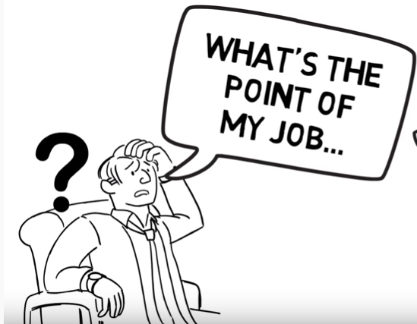
What the world needs
Everyone takes a part in the world and everyone’s work makes a difference
You need to change when to cannot find the point of doing one thing

Slide 6
What you can be paid for
If you don’t have enough money, you will never stop worrying about surviving!
Get paid enough to live comfortably

Slide 7

What you are good at
Put in the time and effort in order to get better skills
Overcome obstacles and improve the skills
Build fulfilling feelings

Slide 8
Myth
Mission 目標
What you love
What the world needs
What you can be paid for
What you are good at

Slide 9
Myth
Passion
熱忱
What you love
What the world needs
What you can be paid for
What you are good at

Slide 10
Myth
Vocation
使命
What you love
What the world needs
What you can be paid for
What you are good at

Slide 11
Myth
Profession
專業
What you love
What the world needs
What you can be paid for
What you are good at

Slide 12
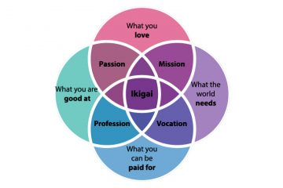
Ikigai

Slide 13
In order to achieve true happiness in your life, you need to do something that you love, that you can get better at, that pays well and that the world needs…

Slide 14
Or…
You will find yourself missing something!

Slide 15
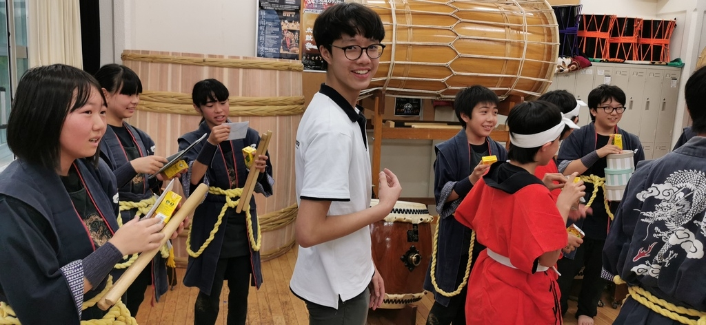
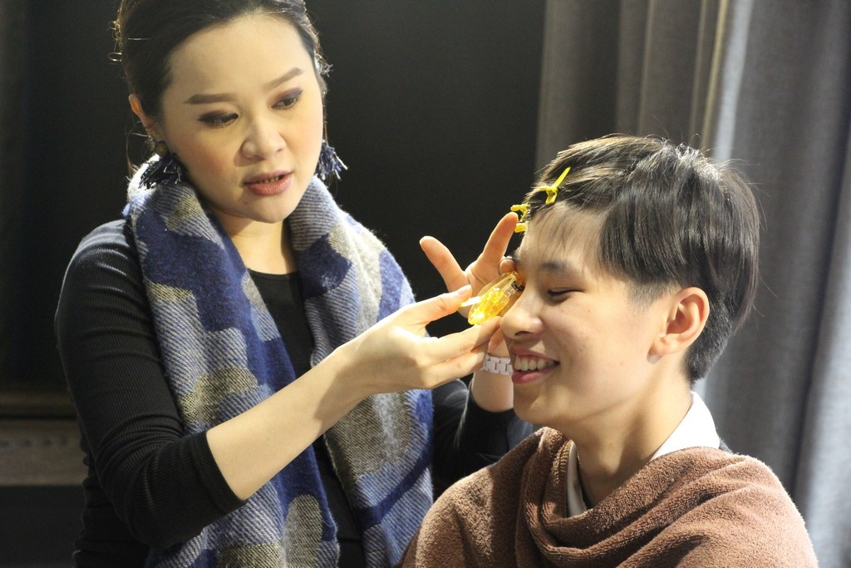
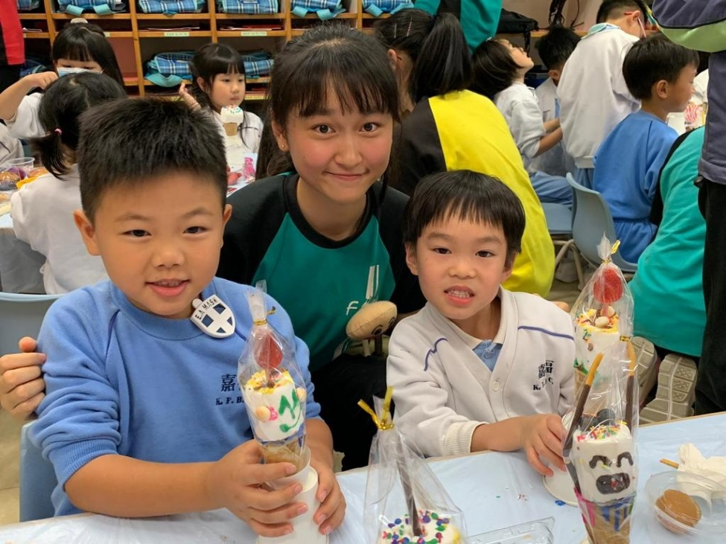
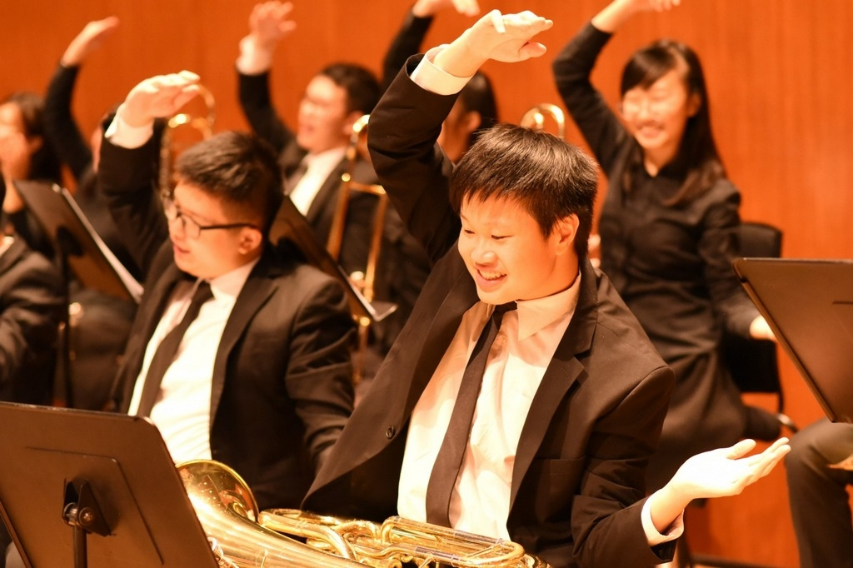

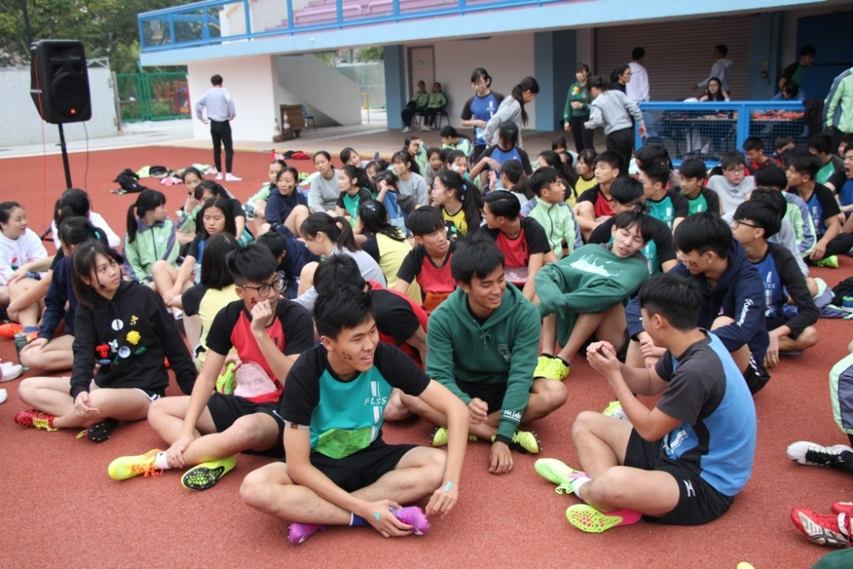
What is your ikigai?

